Slide 1
The Influence of Money in the Premier league
Patrick Thygesen

Slide 2
Background Information
Over the last two decades, the role of finances in sports has become increasingly prominent.
Wealthy team owners often correlate with greater team success and is notably observed in sports lacking salary caps, allowing unchecked spending.
Major League Baseball (MLB) in America - Teams like Dodgers, Yankees, Red Sox attract top players due to affluent ownership which results in consistent success in regular seasons and playoffs.
European Soccer, Manchester City: Acquisition by Abu Dhabi United Group in 2008 worth £17+ billion. Transformation from a trophy-less club since 1968 to seven Premier League titles and achieving the prestigious continental treble.

Slide 3
Background and Information
Positive Aspects:
Enhanced competitiveness and spectacle due to superior teams.
Negative Aspects:
Widening gap between wealthy and less affluent clubs.
Ethical debates on fair competition and financial fair play regulations.

Slide 4
Objective
The goal of this paper is to analyze how the spending of various English Premier League teams over 9 seasons (2013/14 to 2021/22) has influenced their success.
Analyze how each team spends their money on players by looking at how the distribution of money spent across players within their squad impacts success.
Layout of Presentation:
Exploratory Data Analysis
Feature Selection (PCA and Cluster Analysis)
Regression Model Testing and Fitting
Predictive Model Testing and Fitting
Machine Learning Model

Slide 5
Data – Variables
points – the total number of points a team has at the end of a season.
payroll – the sum of all of the players’ salaries.
cv_payroll – the coefficient of variation of the team’s player salaries calculated by the formula: CV=σ/μ where σ is the standard deviation of the players’ salaries and μ is the mean of the players’ salaries.
coach_sal – the salary of the coach (manager) of the team
revenue – the revenue brought into the club from the previous year.
capacity – the capacity of a team’s home stadium.
pedigree – the amount of pedigree a team has. This is based on former years in the English Football division. This is calculated by giving a team 4 points for each season in Division 1 (Premier League), 3 points for each season in Division 2, 2 points for each season in Division 3, and 1 point for each season in Division 4.
promoted – a binary variable where a team is given a value of 1 if they have recently been promoted to the Premier League, and a 0 if they were in the Premier League the previous season.

Slide 6
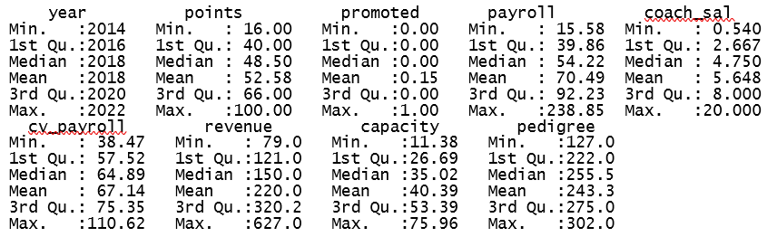
Exploratory Data Analysis – Summary Statistics

Slide 7
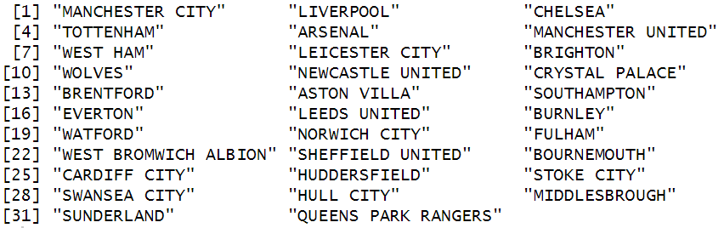
Exploratory Data Analysis

Slide 8
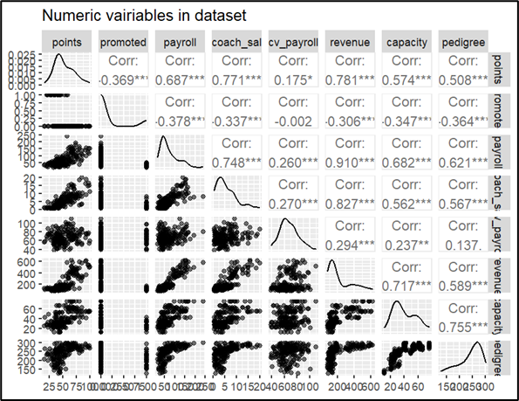
Exploratory Data Analysis - ggpairs
Revenue is highly correlated with most variables
In general, many variables are highly correlated as well

Slide 9
Exploratory Data Analysis
Several of the variables have a non-normal distribution, so several of the variables were adjusted to logarithmic form.
The normality of the variables was explored using density plots
payroll, cv_payroll, revenue, and capacity were all changed to logarithmic forms
points, pedigree, promoted, and coach_sal were left in their normal form

Slide 10
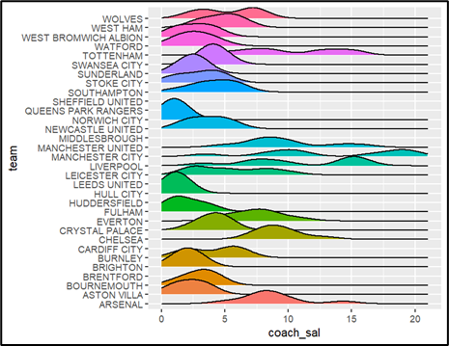
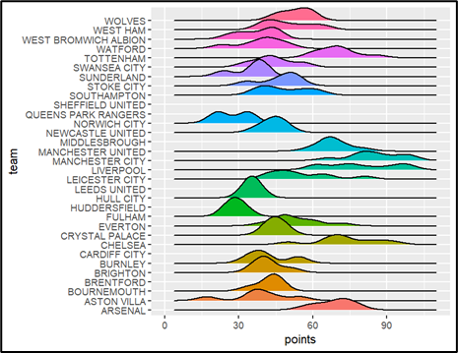
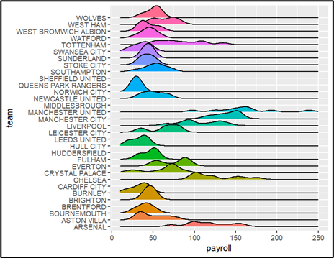
Exploratory Data Analysis

Slide 11
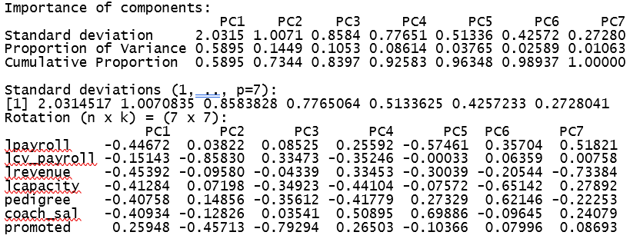
Feature Selection - PCA

Slide 12
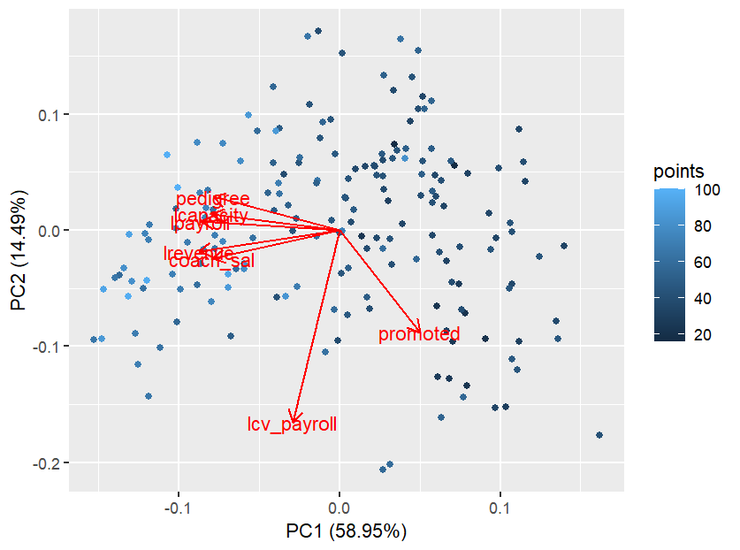
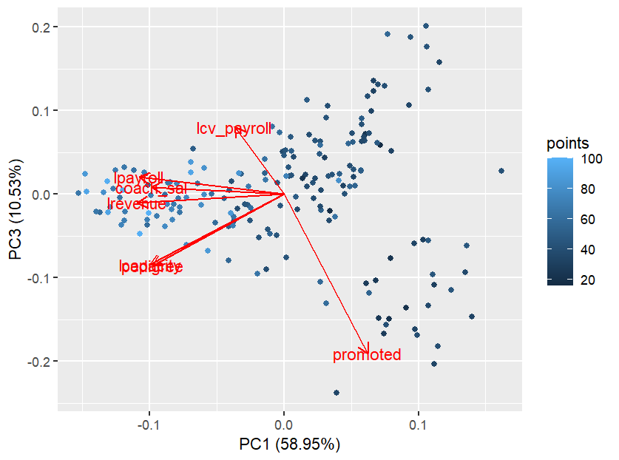
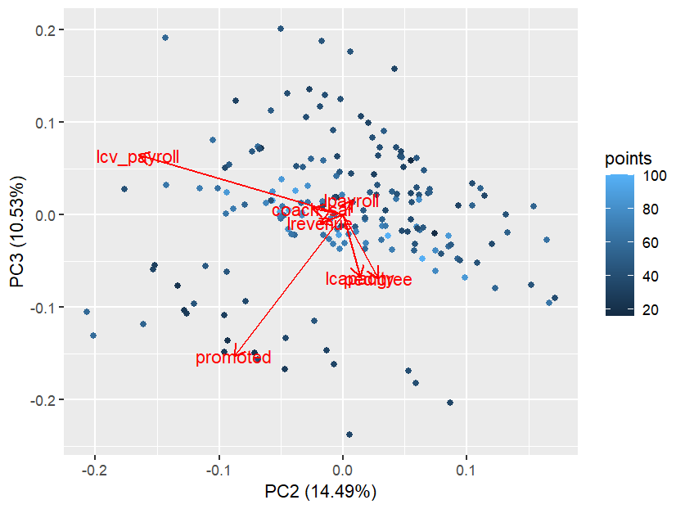
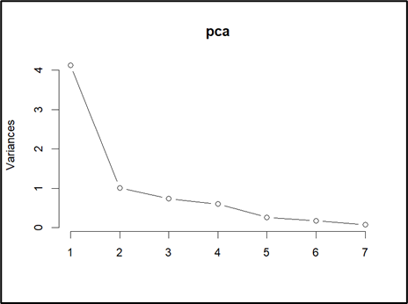
Feature Selection – PCA

Slide 13
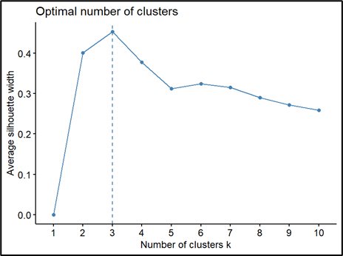
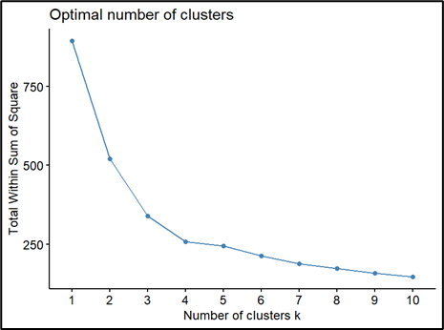
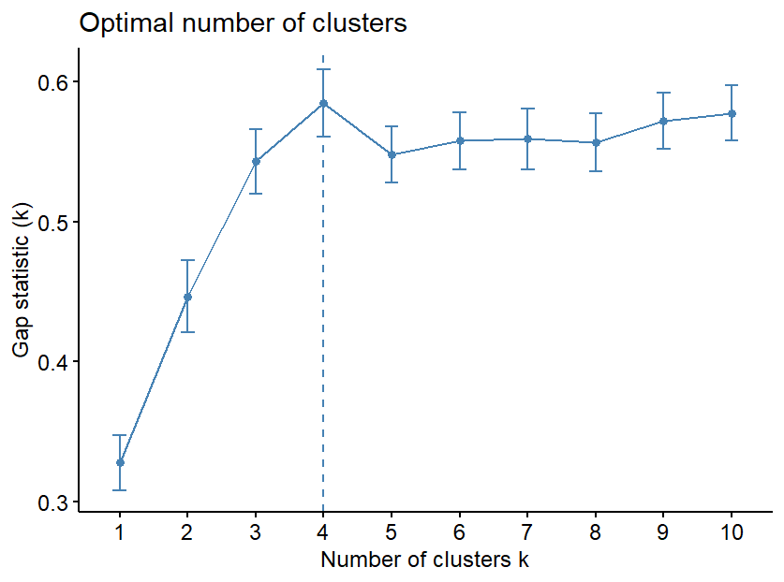
Feature Selection – Cluster Analysis

Slide 14
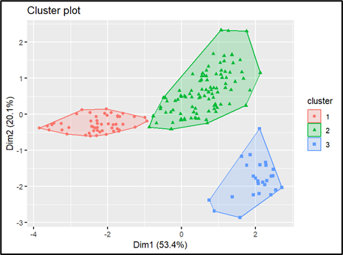
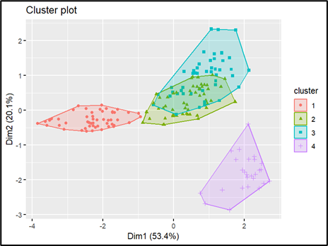
Feature Selection – Cluster Analysis

Slide 15
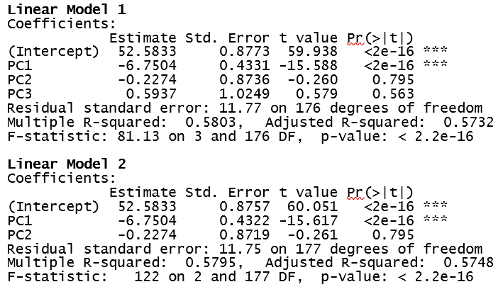
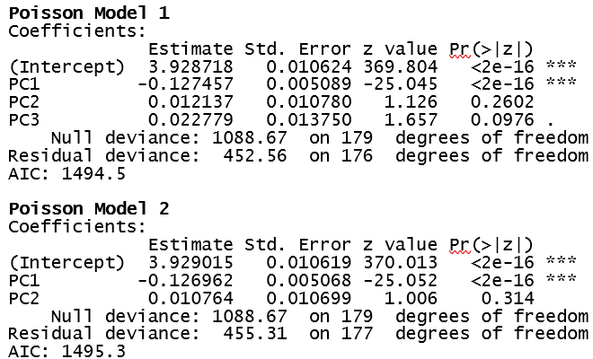
Regression Model Testing and Fitting

Slide 16
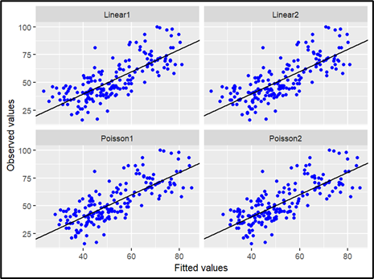
Regression Model Testing and Fitting
In the Observed vs. Fitted values plot, the linear models predict lower values slightly better, and the Poisson models predict higher values better.
Choose first Poisson Regression going forward.

Slide 17
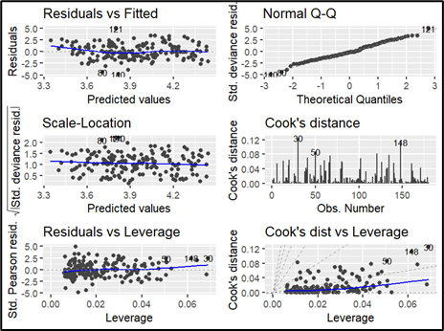
Regression Model Testing and Fitting
Residual vs fitted plot indicates the model has strong linearity.
Normal Q-Q shows that some points deviate from normality but very minimally so the residuals do follow a normal distribution.
The Scale-Location plot shows that the residuals are evenly spread for different fitted values

Slide 18

Regression Model Testing and Fitting
Using a parametric approach, more reliable p-values a were calculated using the boot_summary function.
McFadden’s R-squared value was calculated to be 0.5979561

Slide 19
Predictive Model Testing and Fitting
Two linear models were tested. The first model uses the first three principal components as explanatory variables, and the second model uses the first and second principal components as explanatory variables. The models were tested using leave-one-out cross-validation.
Model 1: points = PC1 + PC2 + PC3
RMSE = 11.88, MAE = 9.56
Model 2: points = PC1 + PC2
RMSE = 11.85, MAE = 9.49
Model 2 appears to have slightly better predictive capability.

Slide 20
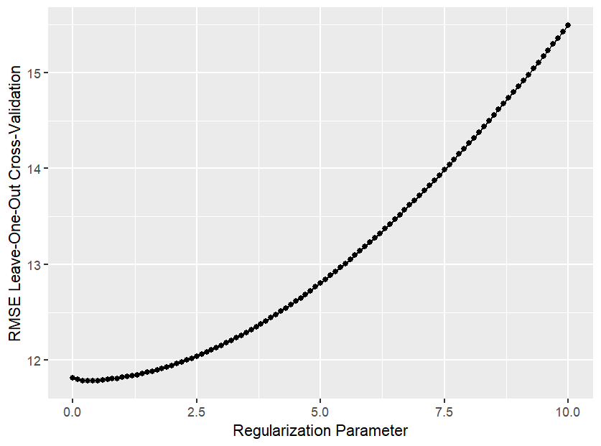
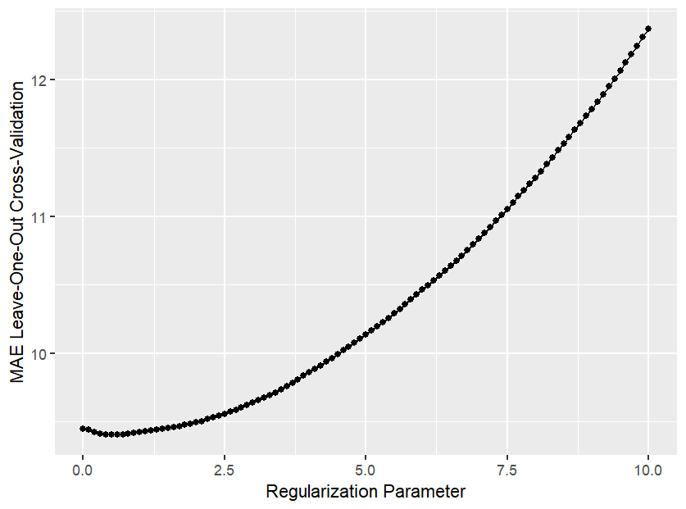

Predictive Model Testing and Fitting
To understand if our model can be better fitted for predictive purposes, the Lasso was run on the second model.
Optimal lambda was found to be 0.5
RMSE = 11.78 and MAE = 9.40
Removed PC2 from the model

Slide 21
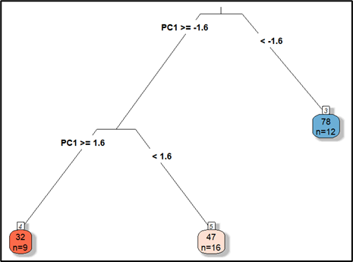
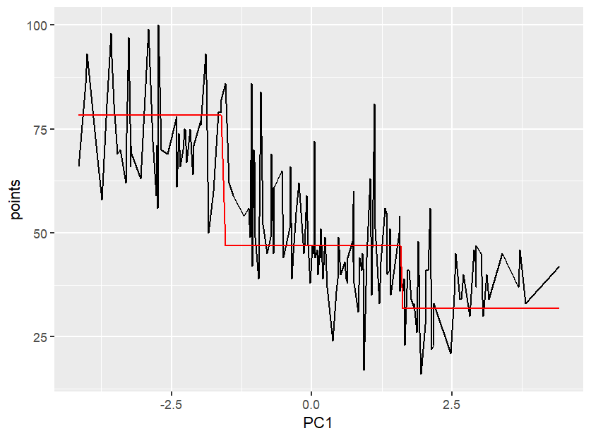
Machine Learning Model
Decision tree was created using the Predictive Model that the Lasso configured, so the first principal component was the only explanatory variable.
Decision Tree was created using the rpart method with an optimal cp parameter 0.6.

